Slide 1

Storm Data Analysis
Kerim Celik, Mandy Cisler,
Elizabeth Morgan, Kevin Nazario,
David Robles

Slide 2
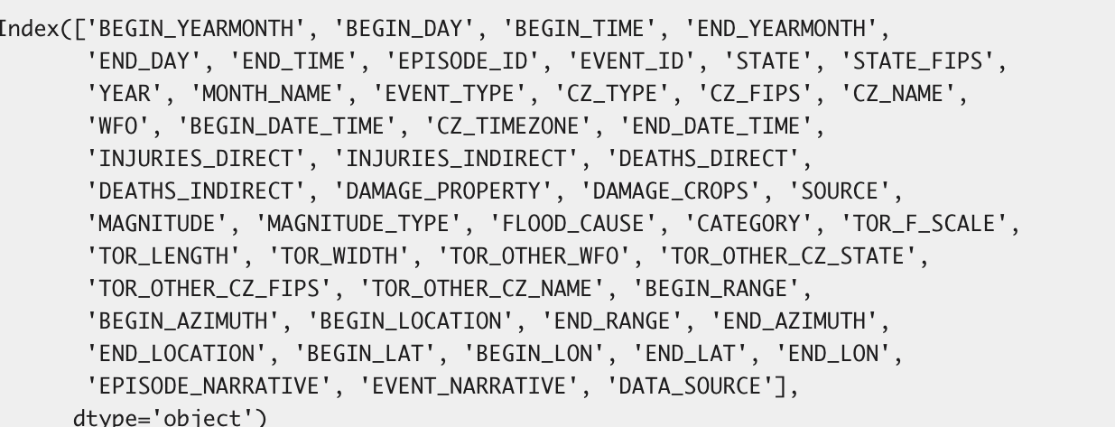
Our Dataset
https://www.ncdc.noaa.gov/stormevents/faq.jsp
The database currently contains data from January 1950 to September 2023, as entered by NOAA's National Weather Service (NWS).

Slide 3
Initial Impressions
Time and location
Type and severity - category, magnitude, tornado scale
Damage, injuries, casualties (crop vs property damage, direct vs indirect)
Narrative information
Data source (trained spotter, public, emergency manager, law enforcement, etc.)
948,286 total rows in our 2008-2022 dataset; 13,924 rows (1.5%) in our final dataset
22,087 total rows in our 1950-1964 dataset; 1,139 rows (5.2%) in our final dataset

Slide 4
Why look at storms?
Weather Patterns
Climate Change Impact
Damage, Risk, and Infrastructure
How storms are measured (Fujita scale)
Mapping (latitude and longitude)

Slide 5
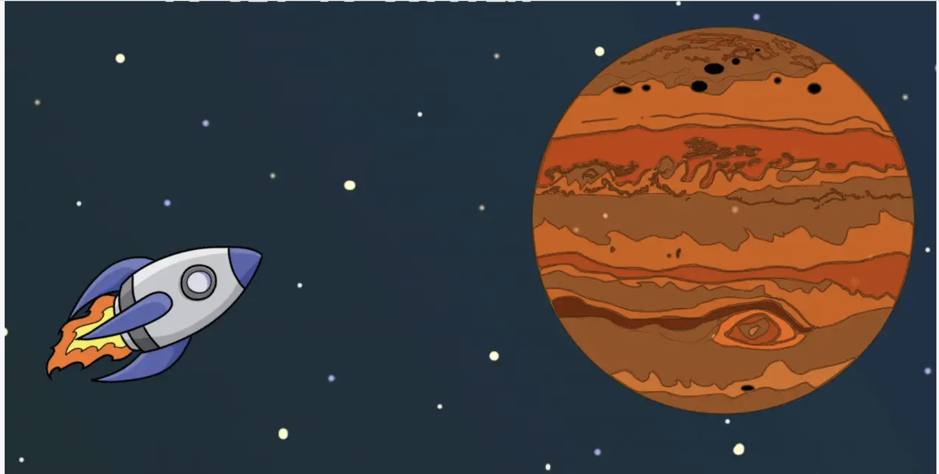
Data Exploration & Cleanup Process

Slide 6
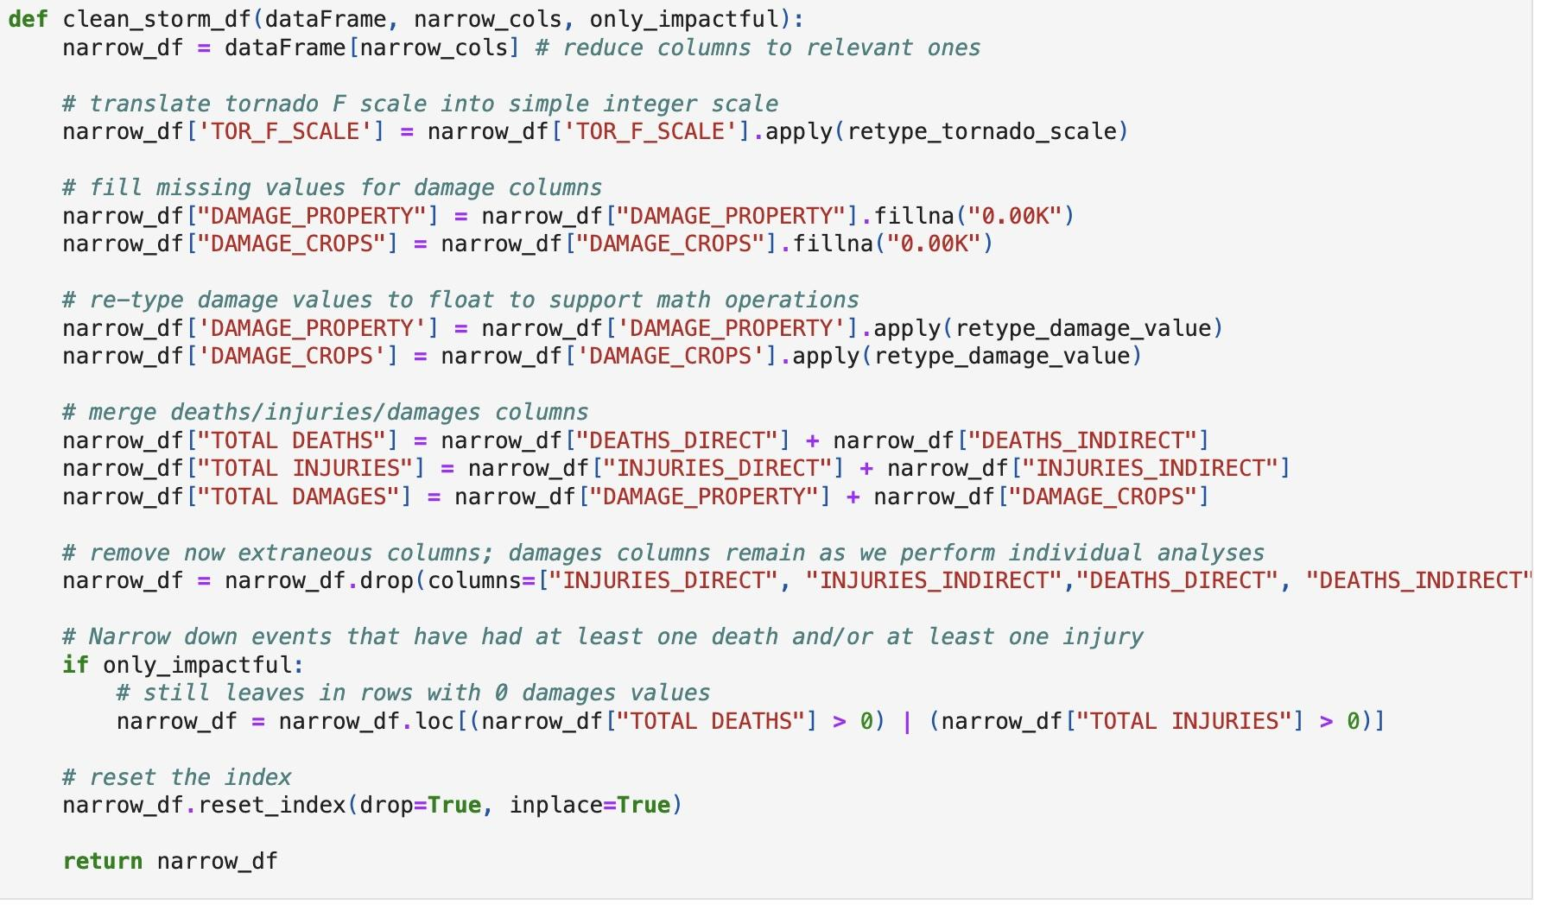

Slide 7

The Analysis Process
Notes:
Kevin

Slide 8
Research Question 1
What has been the impact of storms over recent years? Is there a correlation between storm fatalities and total damages? What are the differences in storm impacts between the most recent 15 years and the initial 15 years?
Notes:
Kevin

Slide 9
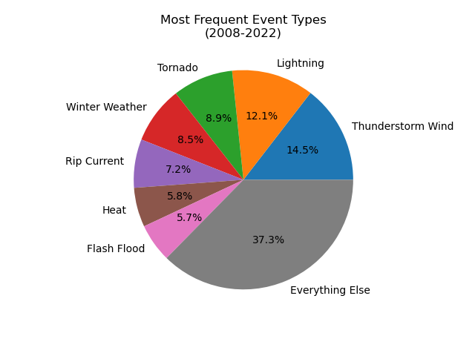
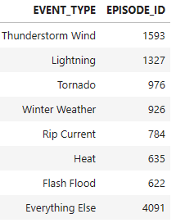
Notes:
Kevin

Slide 10
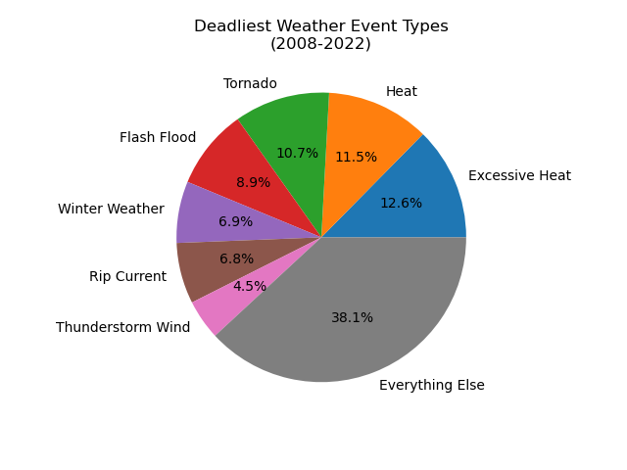
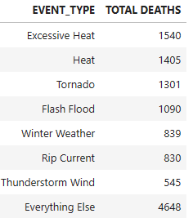
Notes:
Kevin

Slide 11
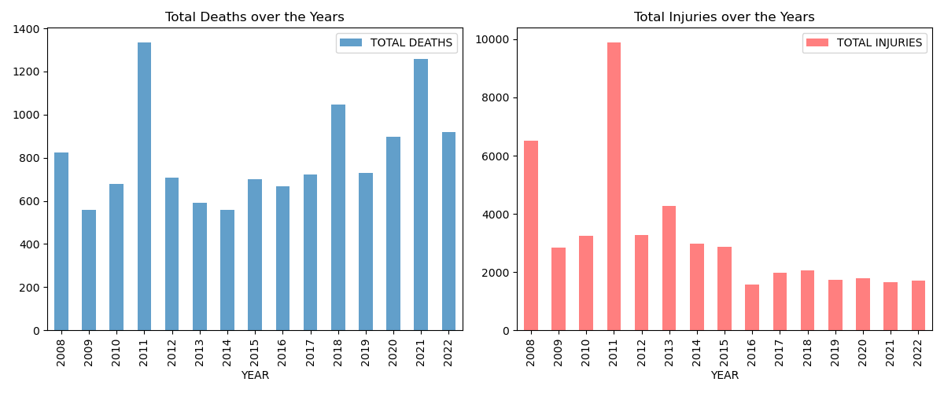
Trends Over Time
Notes:
Kevin

Slide 12
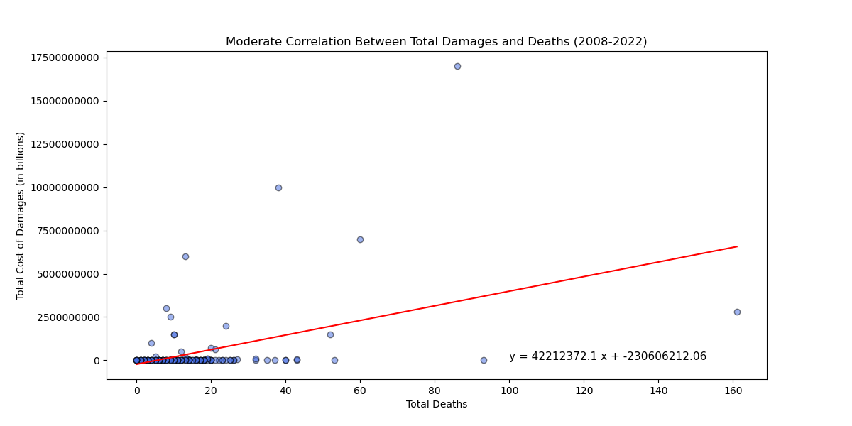
Is there a correlation between storm fatalities and total damages?
Pearson-R = .43
Notes:
Mandy

Slide 13
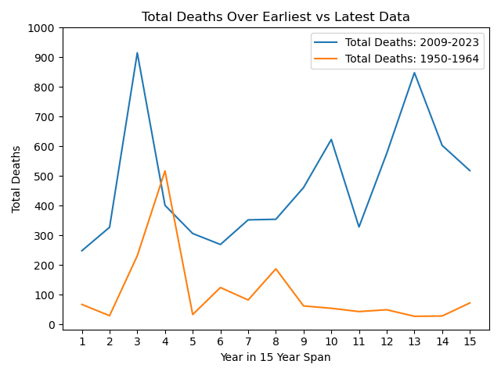
Comparison of Total Deaths Between Earliest Data and Most Recent Data
Notes:
David

Slide 14
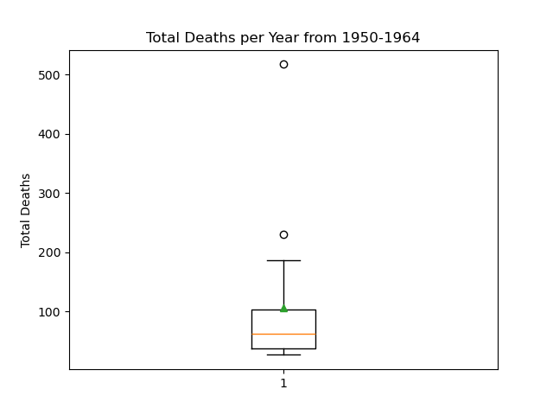
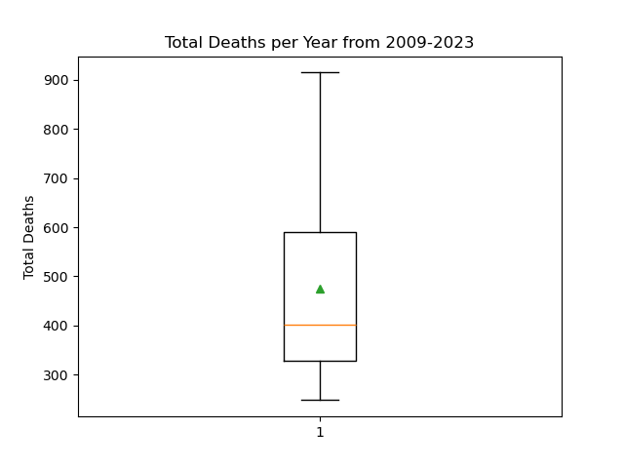
Total Deaths per Year for Both Datasets
The lower quartile of total deaths is: 38.0
The upper quartile of total deaths is: 103.0
The interquartile range of total deaths is: 65.0
The the median of total deaths is: 62.0
The mean of total deaths is: 107.0
Values above 200.5 could be outliers.
The lower quartile of total deaths is: 327.5
The upper quartile of total deaths is: 589.5
The interquartile range of total deaths is: 262.0
The the median of total deaths is: 401.0
The mean of total deaths is: 475.3
Values above 982.5 could be outliers.
Notes:
David

Slide 15
Research Question 2
Given that tornadoes are one of the most frequent event types and among the most destructive and deadly in our dataset, do tornadoes with greater magnitudes result in increased property damage?
Notes:
Elizabeth

Slide 16
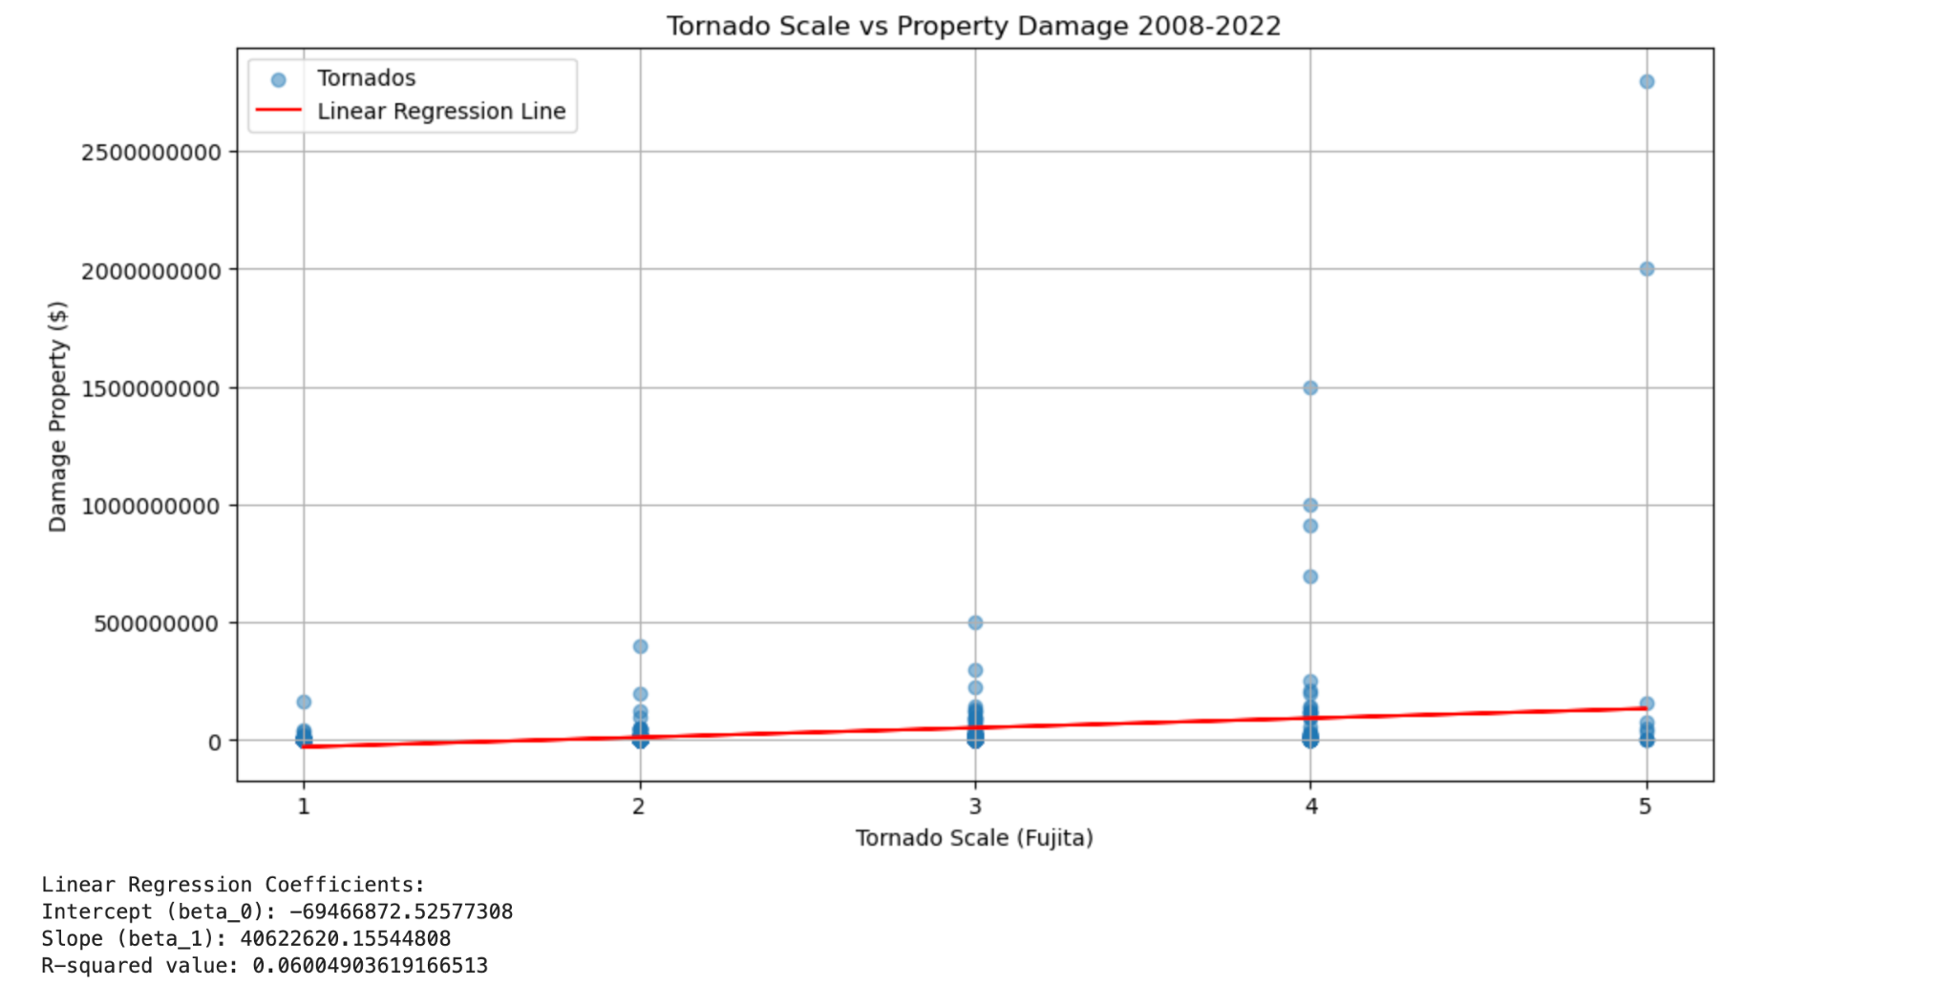
Tornadoes
Notes:
Elizabeth

Slide 17
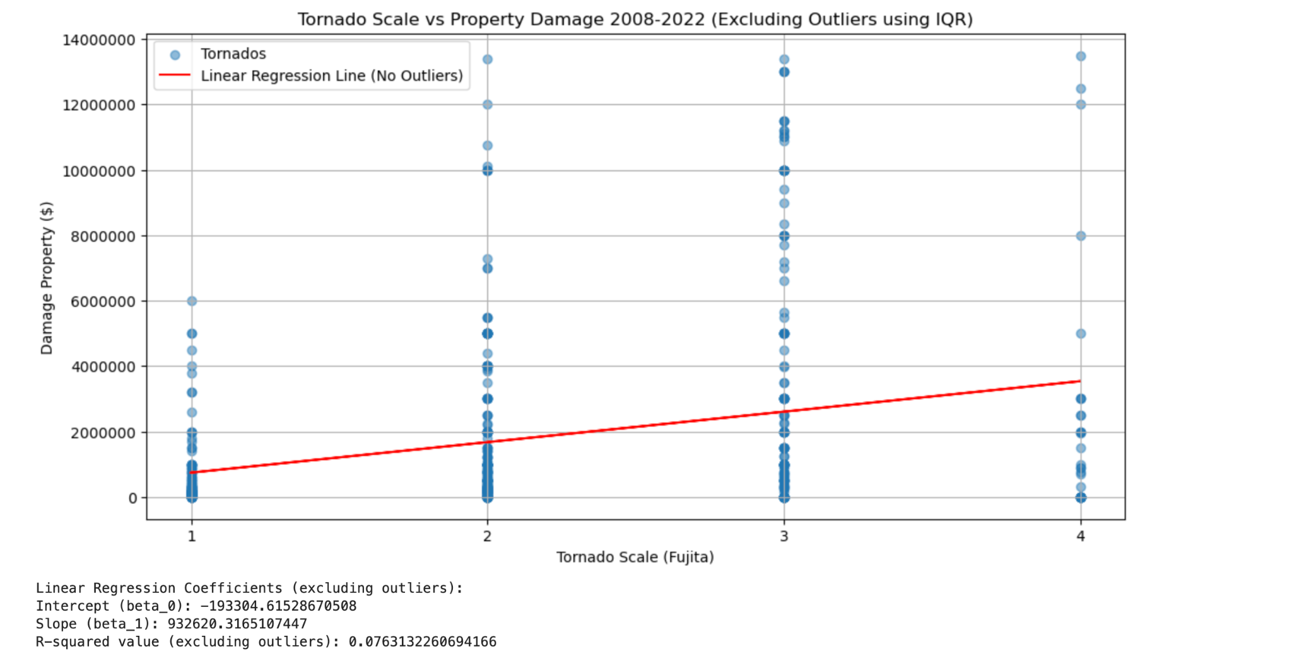
Tornadoes cont.
Urban areas — a developed place with more than 50,000 people — are home to 80 percent of the population but account for just 3 percent of the land space in the United States. (Source: US Census Bureau)
Notes:
Elizabeth

Slide 18
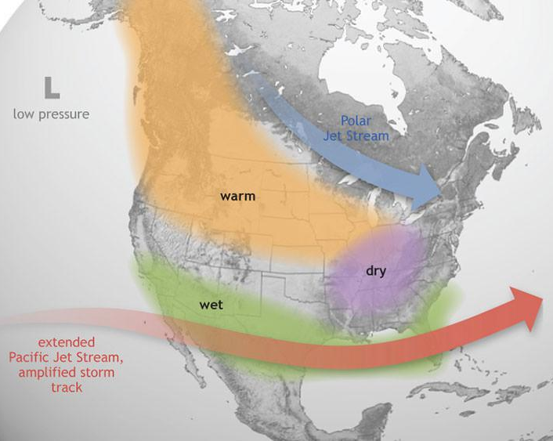
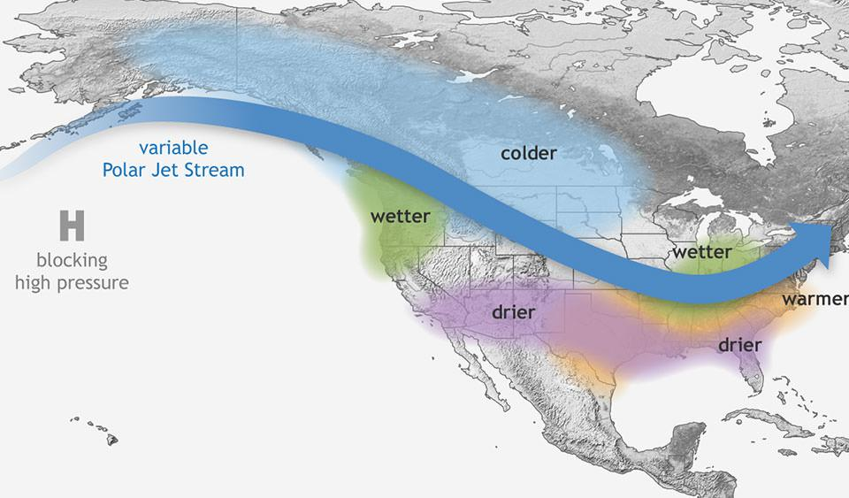
Research Question 3
Can we observe any effects of the El Nino / La Nina weather patterns within this dataset?
El Nino
La Nina
Notes:
Images source: https://oceanservice.noaa.gov/facts/ninonina.html
Kerim
Trying to get meaningful results using statistical analysis on related phenomena not directly contained in the dataset
El Nino / La Nina, which have effects on climate throughout the US

Slide 19
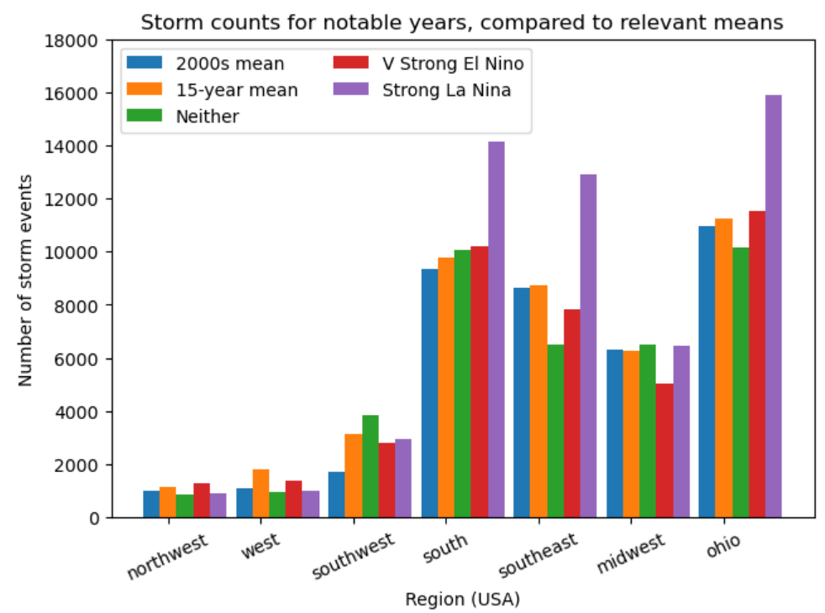
Regional counts and patterns
Do years with stronger weather patterns have more storms than average?
Do these patterns have different effects on each region within the US?
Initial investigation
Notes:
Kerim
Initial investigation
Count storm events in different regions
Look at strong years in the record
Compare with current and previous decade means
Interesting: current mean > previous mean and La Nina has large effect on central US

Slide 20
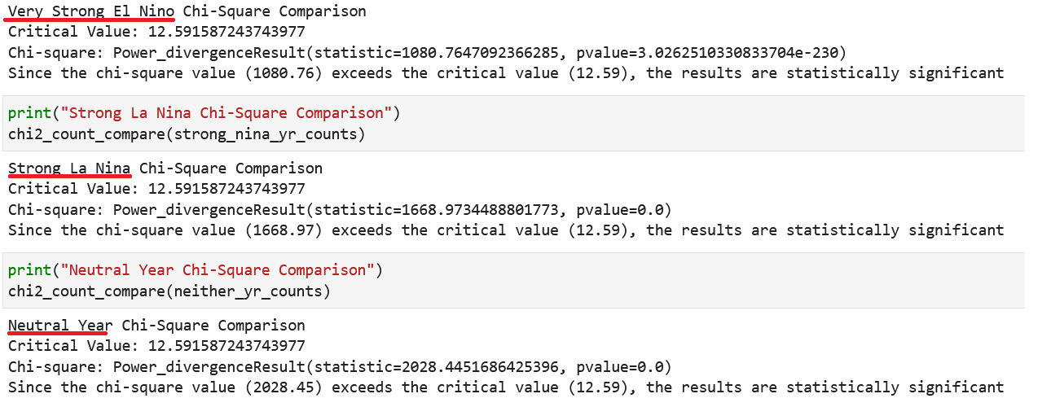
Regional patterns (cont.)
Attempt chi-square between “baseline” and interesting, recent year data
Conclusion: all of these years are distinct from the mean regional counts for 2000-2011
Notes:
Kerim
Attempted to show strong years are distinct using chi-squared analysis
Compare to previous decades mean as the “expected” distribution
All results are distinct from chi-squared results, but very low p-values are fishy

Slide 21
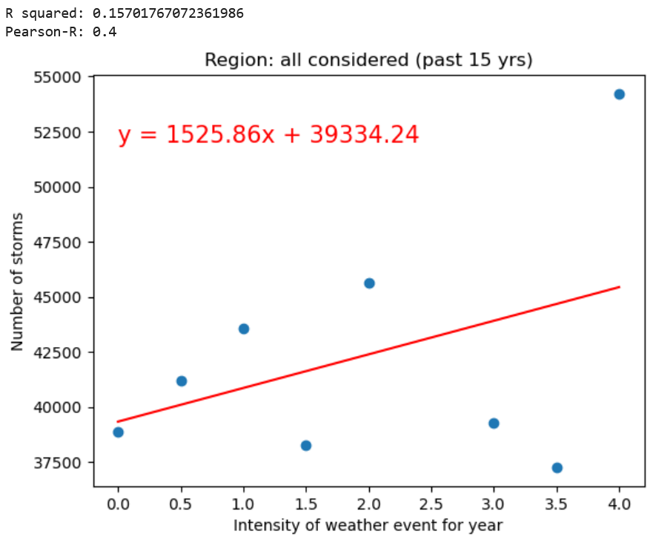
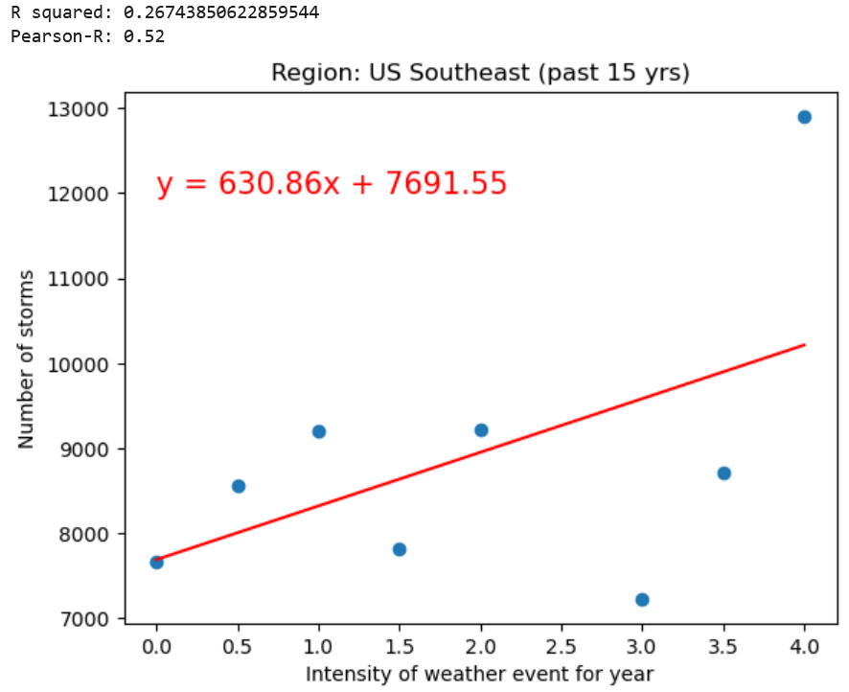
Correlating: “Best” results
Notes:
Kerim
Then tried to correlate strength of El Nino / La Nina to number of storm events in regions
Generally poor results: best ones shown here, with greatest r-squared at 0.26
Learning was that tying these larger, tangentially-related phenomena to our dataset using analysis is difficult
Requires greater understanding of storms and El Nino / La Nina;
Did not help that chosen statistical analyses all felt like stretches too
If had a second chance, unfortunately think I’d start again from scratch

Slide 22
Limitations & Next Steps
Inconsistencies in the dataset made initial goals difficult to achieve
Challenges in cross-year comparisons due to changes in data collection methods
Next Steps:
Further investigating the impact of outliers
Exploring individual event types and comparing over larger periods of time
Other definitions of impact could be explored (aside from fatalities, injuries, and damages)
Notes:
Mandy

Slide 23
THE END

